Slide 1
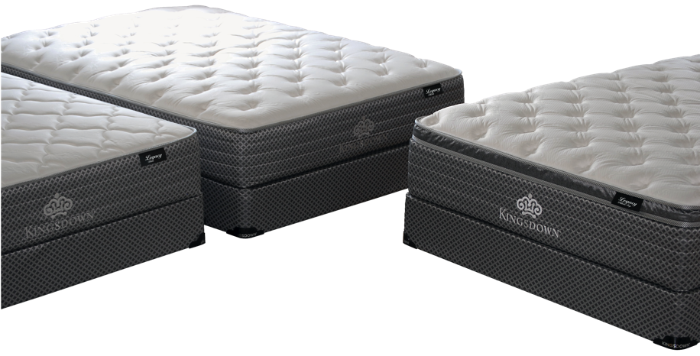
KINGSDOWN LEGACY
MODEL # | 2053 | 2054 | 2110
NAME / COMFORT LEVELS | Legacy Pillow Top | Legacy Plush | Legacy Firm
QUILT | .7 oz FR Fiber 1 ¼” Quilting Poly 1 oz Conjugate Fiber |  | .7 oz FR Fiber 7/16” Quilting Poly 7/16” Quilting Poly
PILLOW/EURO | 1 ½” Conv. Support Foam 1 ½” Conv. SuperSoft Foam | n/a | n/a
COMFORT UPHOLSTERY | 1” Firm Kingsfoam ¾” Foam | 1 ½” Conv. SuperSoft 1” SuperSoft ¾” Foam | 1 ½” Conv. Firm Kingsfoam 1” Firm Kingsfoam ¾” Foam
LUMBAR SUPPORT | 3/8” CHILLY WAVE™ Lumbar Support Band
COIL UNIT | Versare Layer 7” 14 Ga. Twin: 360 Full: 520 Queen: 630 King 798 Versare Layer
BASE UPHOLSTERY | ¾” Base foam ¾” Base foam | ¾” Base foam
EDGE SUPPORT | Full Body Surround™
FOUNDATION/ BOX SPRING | Wood
WARRANTY | 10 Years
LEGACY

Slide 2
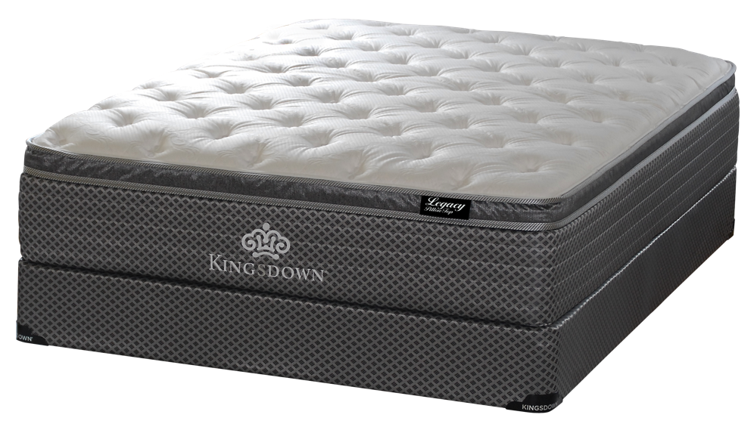
HEIGHT: 15.5”
QUILT
.7 oz FR Fiber
1 ¼” Quilting Poly
1 oz Conjugate Fiber
PILLOW TOP
1 ½” Conv. Support Foam
1 ½” Conv. SuperSoft Foam
UNIT
1” Firm Kingsfoam
3/8” CHILLY WAVE™
Memory Foam
Lumbar Support Band
¾” Foam
Versare Layer
InnerSpring Coil Unit
360 Twin
520 Full
630 Queen
798 King
Versare Layer
¾” Base Foam
¾” Base Foam
Edge Support
Full Body Surround®
Box Spring
Wood
WARRANTY
10 Years

Slide 3
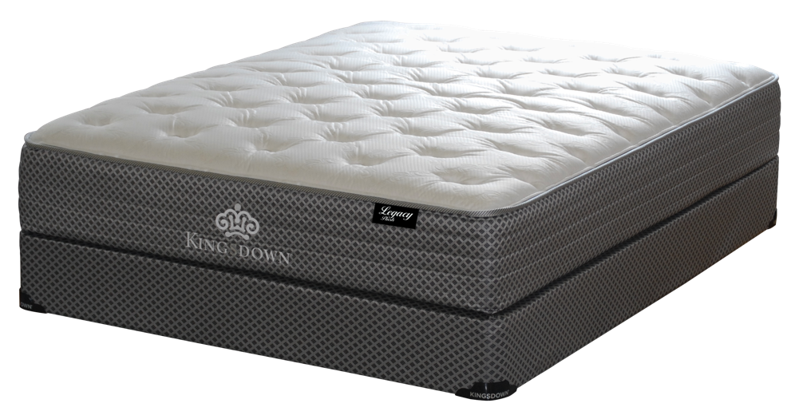
HEIGHT: 13”
QUILT
.7 oz FR Fiber
1 ¼” Quilting Poly
1 oz Conjugate Fiber
UNIT
1 ½” Conv. Support Foam
1” SuperSoft Foam
3/8” CHILLY WAVE™
Memory Foam
Lumbar Support Band
¾” Foam
Versare Layer
InnerSpring Coil Unit
360 Twin
520 Full
630 Queen
798 King
Versare Layer
¾” Base Foam
Edge Support
Full Body Surround®
Box Spring
Wood
WARRANTY
10 Years

Slide 4
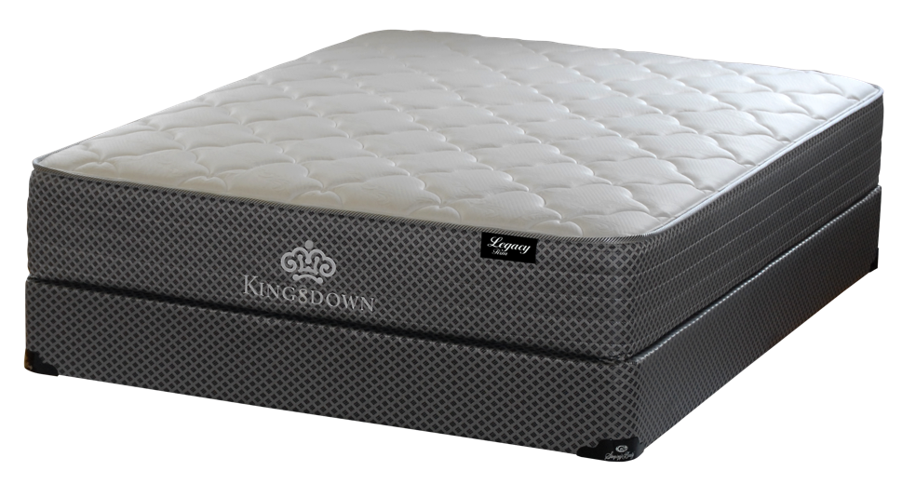
HEIGHT: 13”
QUILT
.7 oz FR Fiber
7/16” Quilting Poly
7/16” Quilting Poly
UNIT
1 ½” Conv. Firm Kingsfoam
1” Firm Kingsfoam
3/8” CHILLY WAVE™
Memory Foam
Lumbar Support Band
¾” Foam
Versare Layer
InnerSpring Coil Unit
360 Twin
520 Full
630 Queen
798 King
Versare Layer
¾” Base Foam
Edge Support
Full Body Surround®
Box Spring
Wood
WARRANTY
10 Years

